Slide 1
Instrument API and XML Method Modification Interface A brief introduction
Tony Zhao and Jesse Canterbury

Slide 2
Overview
Instrument Application Programming Interface (IAPI)
Introduction
Architecture
Example
XML Method Modification Interface (XMMI)
Architecture
Example
Notes:
Overview of the first half of today
Some special guest presenters on their experience using these tools

Slide 3
Overview
Instrument Application Programming Interface (IAPI)
Introduction
Architecture
Example
XML Method Modification Interface (XMMI)
Architecture
Example
Notes:
Overview of the first half of today
Some special guest presenters on their experience using these tools

Slide 4
Why an API?
“Can I do this in method editor?”
“I wish I could do …”
“I only want to select peaks that have odd masses …”
“I have this awesome new experiment …”
Notes:
Why an API?
Lots of questions about doing cool things without mass spectrometers

Slide 5
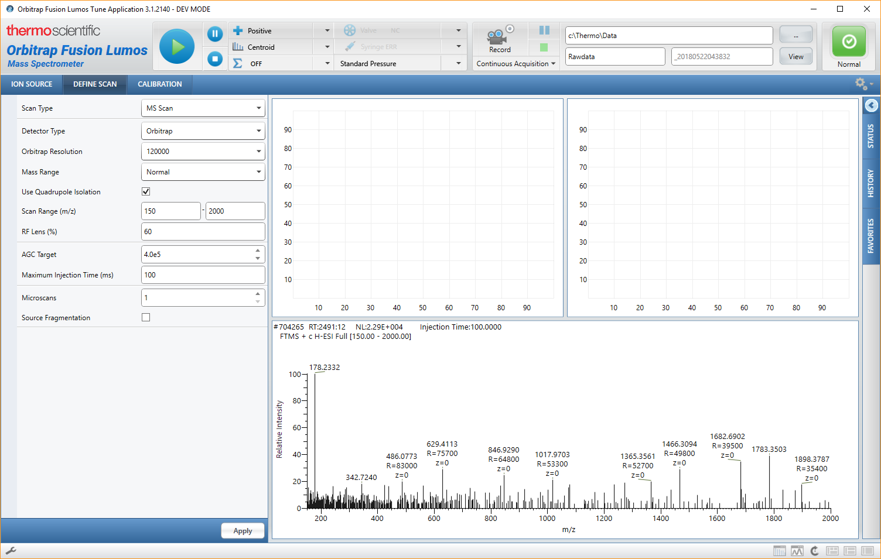
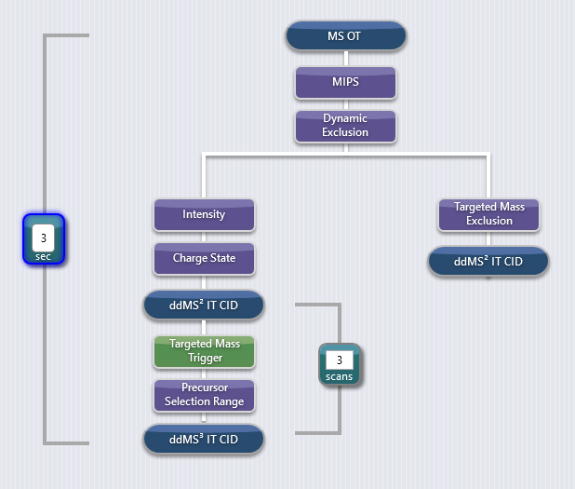
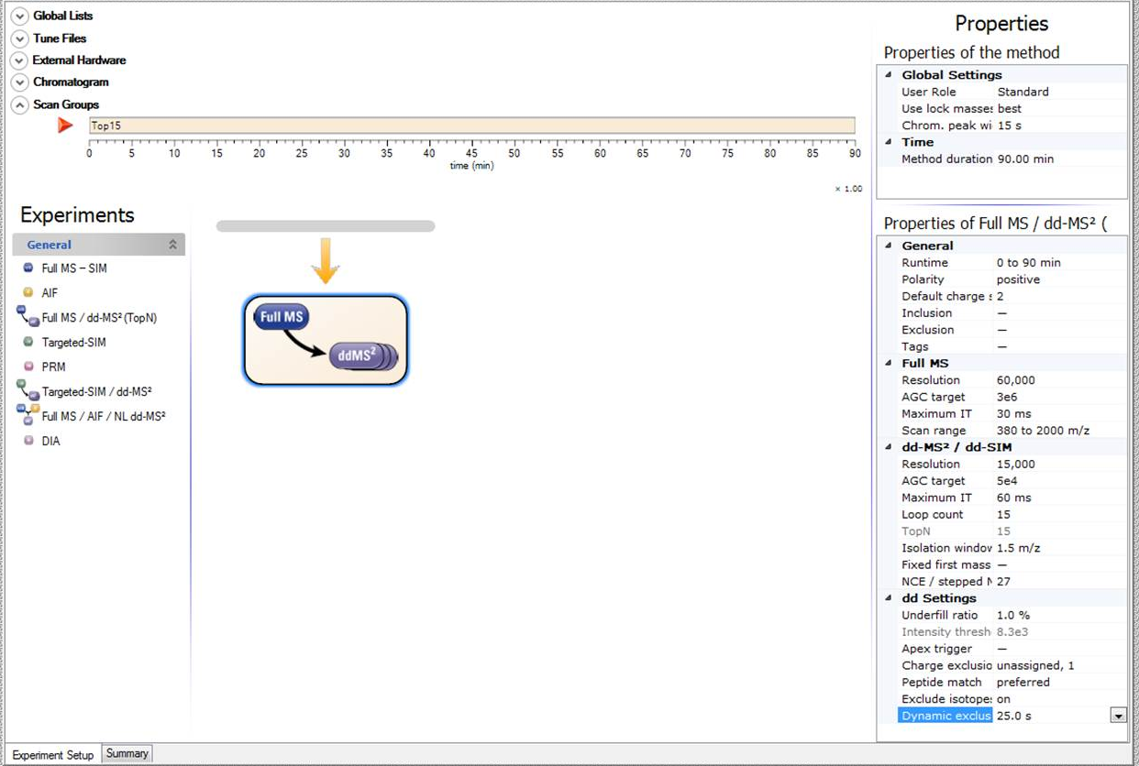
Why an API?
“Can I do this in method editor?”
“I wish I could do …”
“I only want to select peaks that have odd masses …”
“I have this awesome new experiment …”
Users can only control the Mass Spectrometer through our Tune application and Method acquisition.
Although both provide great flexibility in acquisition strategies they don’t encompass all possibilities.
Providing an Application Programming Interface enables users to extend the capabilities of Thermo Scientific™ Orbitrap™ mass spectrometers.
Allows real-time data acquisition and control.
Can be used with Thermo Scientific™ Exactive™ and Thermo Scientific™ Tribrid™ MS systems
Notes:
We provide both Tune and Method Editor to allow flexibility, but not everything is possible
By providing an API, we can extend the capabilities of the MS
It also allows real-time control of the MS

Slide 6
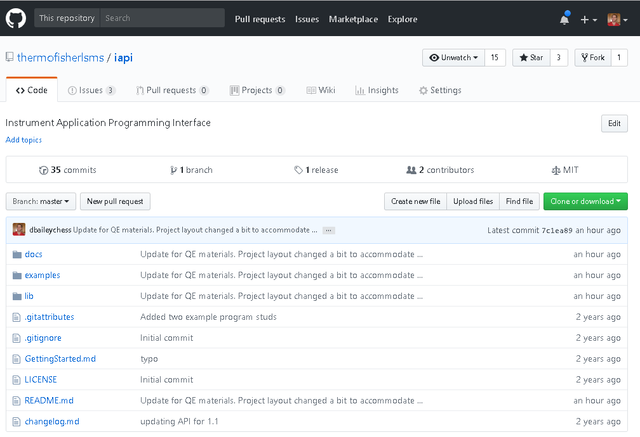
Instrument API Git Repository
https://github.com/thermofisherlsms/iapi
Public interfaces for
Thermo Scientific Tribrid MS
Thermo Scientific Exactive MS
Documentation
Previous ASMS Posters
Help files
VS Solution of Example Applications
External Requirements
Tune Installation
.NET 4.6.2+
License Agreement in place
IAPI License Key Activated
Notes:
Again, the IAPI is hosted on our GitHub page
It contains all the interfaces and documentation to get started
You’ll need a few things to use it

Slide 7
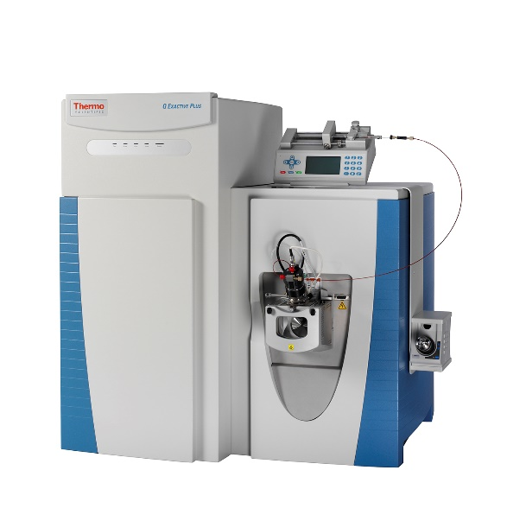
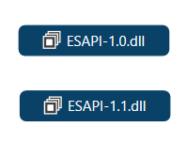
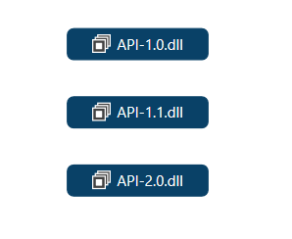

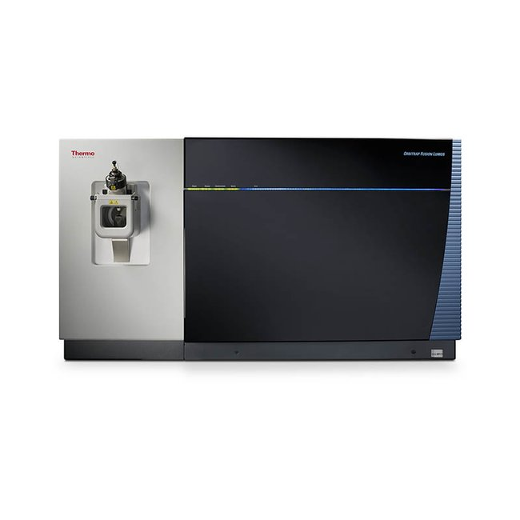
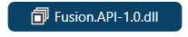
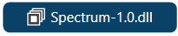

Interfaces
Thermo Scientific Exactive Series
IAPI Version
Instrument Extensions
Misc.
Thermo Scientific Tribrid Series
All interfaces are in the git repository, in the lib/ directory
Notes:
We have two IAPI-enabled instruments lines
The Exactive series came first with the first API definitions
It is broken into multiple assemblies.
The Tribrid series came next, with a newer API definition
Here again, we have the extensions for the Fusion API

Slide 8
Differences and Similarities between Exactive and Tribrid Series IAPI
Although IAPI 1.X (supports Exactives) is not binary compatible with IAPI 2.X (supports Tribrids), they share considerable amount of structure
Namespaces and hierarchies are virtually unchanged
A few name changes or minor reorganization
Removal of some interfaces
Spectrum-related interfaces moved into own assembly
The logical flow for both receiving scan data and sending scans definitions to the instrument is identical
Different methods for instantiating the IAPIs
Tribrid-series uses a Factory method model with Microsoft’s Managed Extensibility Framework (MEF)
Exactive-series uses the System.Reflection.Assembly API
Notes:
I would like to highlight some of the differences between the exactive and tribrid APIs

Slide 9
The rest of this presentation will focus on the Tribrid-series IAPI.
Most topics are applicable to the Exactive-series with minor differences.

Slide 10
IAPI Outline
IAPI Architecture
Interfaces
Data and Control Flow
Receiving Data from the MS
Interfaces
Scan Data Stream Subscription
Controlling the MS
Sending Scan Definitions
Changing other MS parameters
Getting Started
Notes:
A lot of you probably don’t know the architecture of our mass spec system. So I will briefly walk through different components.

Slide 11
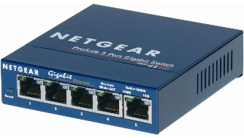


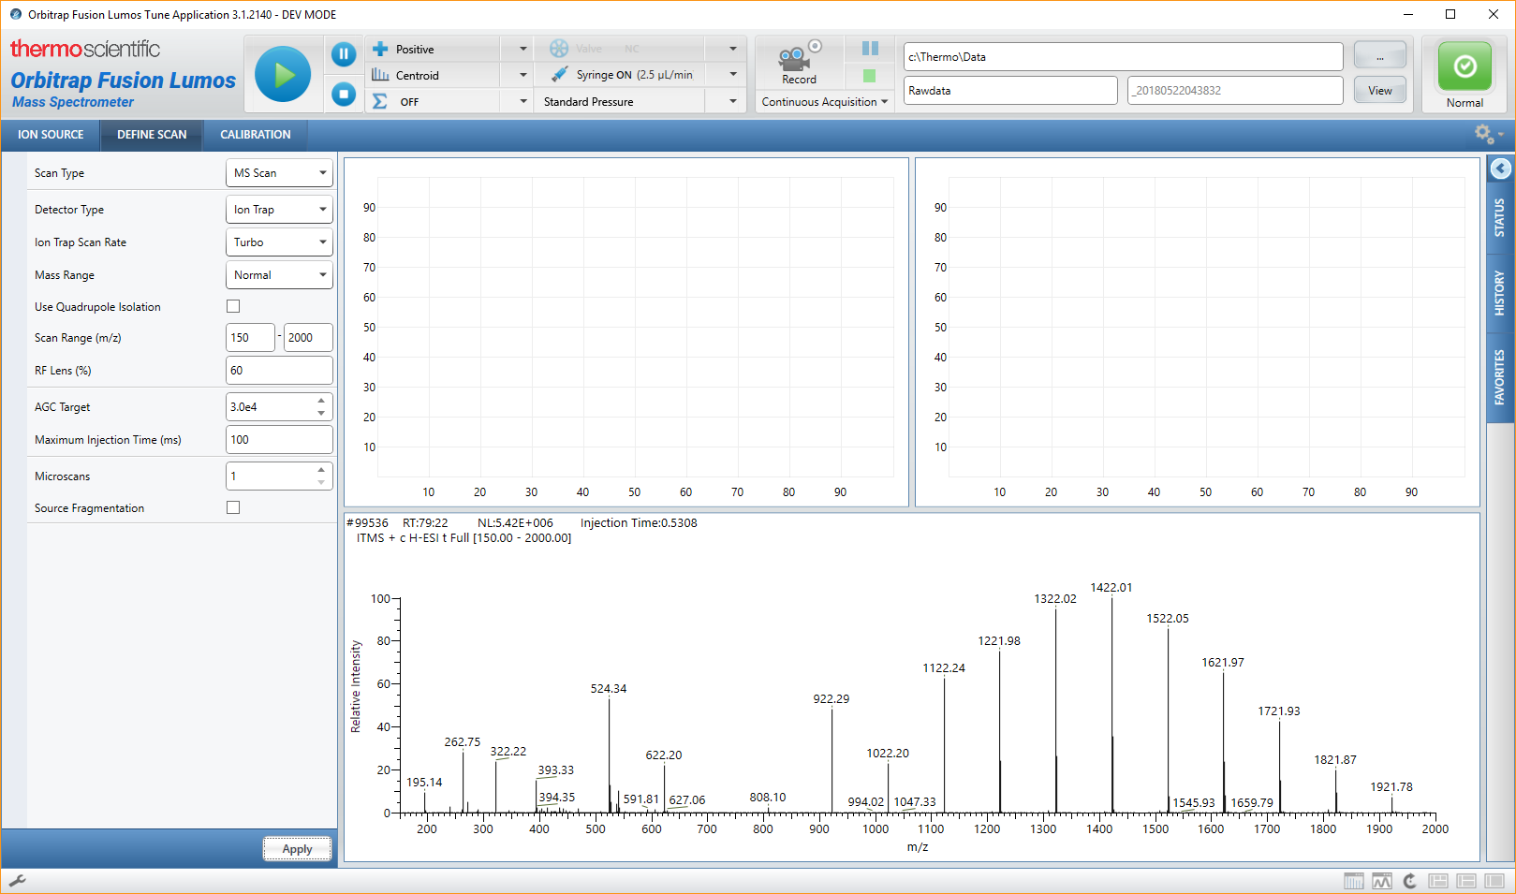
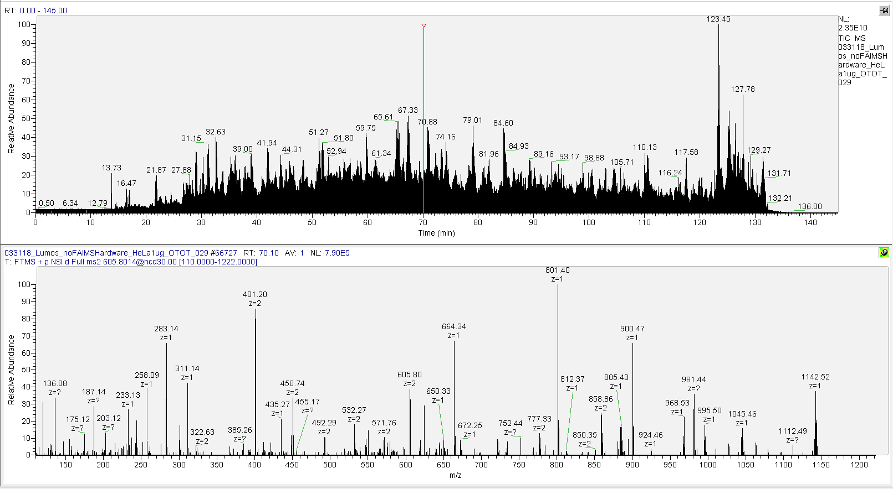
MS Architecture
Mass Spectrometer
Local Switch
Data System
Instrument
Service
Tune Application
Rawfile
Notes:
Here is the basic lay out of the MS architecture
The ms talk to data system over network/a switch. The data system runs the instrument service. The instrument service provide data to both the tune app, but also write to the raw file

Slide 12
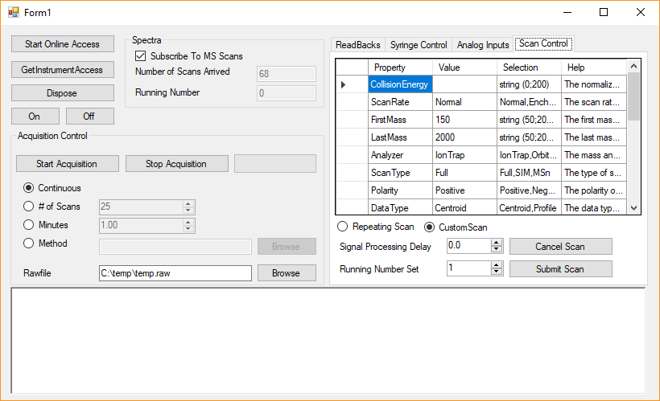

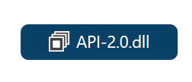
IAPI Architecture
Mass Spectrometer
Local Switch
Data System
IAPI-Enabled App
Instrument
Service
3rd Party
Application
Tune Application
Rawfile
Notes:
So the API is basicly integrated into this instrument service.
The 3rd party app you guys write can talk to the API. And downstream everything is the same

Slide 13
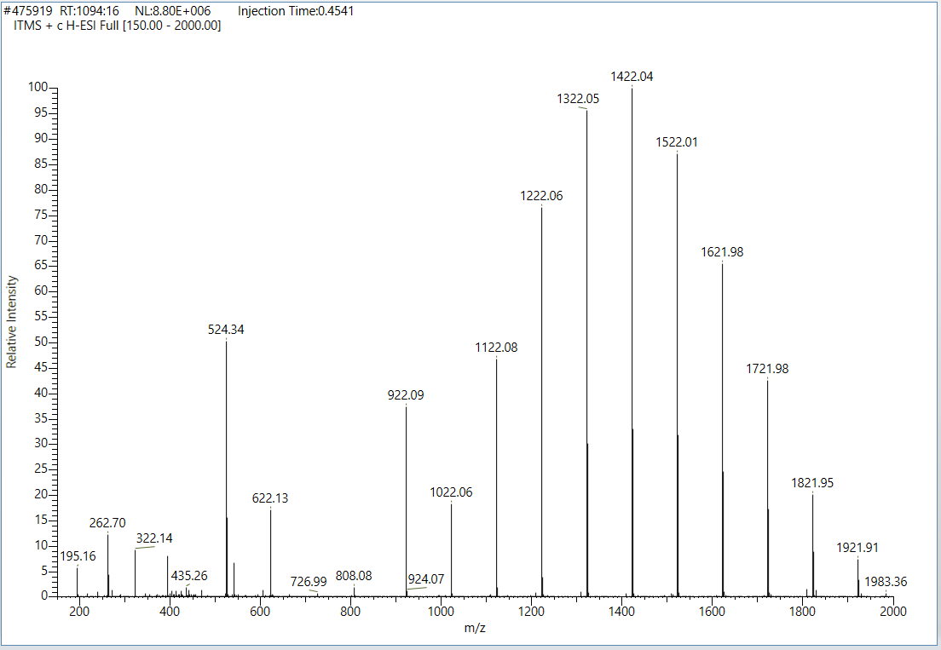
IAPI Data and Control Flow
Mass Spectrometer
Data System
Instrument
Service
3rd Party
Application
Displays scan in Tune
Writes to Rawfile
Forwards data to API
Converts data into IAPI format
Raises Event to any subscribers
Handles scan Event
Processes the data
Do whatever you want!
Scan Data
Stream
Notes:
This is kind of a summary of the previous slice.
In terms of control flow, it has 3 layers, the instrument service, the API and the your application.
The mass spec is generating some spectra, it first reach instrument service which displays the scan in Tune, it writes to RawFile and Forwards data to API.
Now inside API, it kind of converts data into IAPI format, and it will raise events to any subscribers that listen on the IAPI side.
The application layer will have an event handler that handles the scan event data, and basicaly do whatever you want.

Slide 14
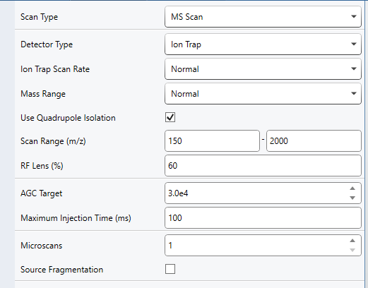
IAPI Data and Control Flow
Mass Spectrometer
Data System
Instrument
Service
3rd Party
Application
Displays scan in Tune
Writes to Rawfile
Forwards data to API
Converts data into IAPI format
Raises Event to any subscribers
Handles scan Event
Processes the data
Do whatever you want!
Scan Data
Stream
Logs event
Downloads scan definition to instrument
Validates scan definition
Forwards scan to Instrument Service
Calls IAPI to create IScanDefinition object
Changes definition as sees fit
Scan Definition
Notes:
That’s the basic data flow, now if you want to change what the mass spec is doing, maybe after the event, you can generate a IScanDefinition object in the IAPI, and you modify that definition whatever you sees fit.
You send it thru the API, that validates the scan definition, and then forwards it into the instrument service.
Instrument service logs the scan event, and downloads it to the instrument. Here I show a cut-out image of the scanDefinition table in Tune, to kind of show what a scan definition looks like.
And that will influence how instrument is taking scans.

Slide 15
IAPI Outline
IAPI Architecture
Interfaces
Data and Control Flow
Receiving Data from the MS
Interfaces
Scan Data Stream Subscription
Controlling the MS
Sending Scan Definitions
Changing other MS parameters
Getting Started
Notes:
Lets dig in deeper into the receiving side of things

Slide 16
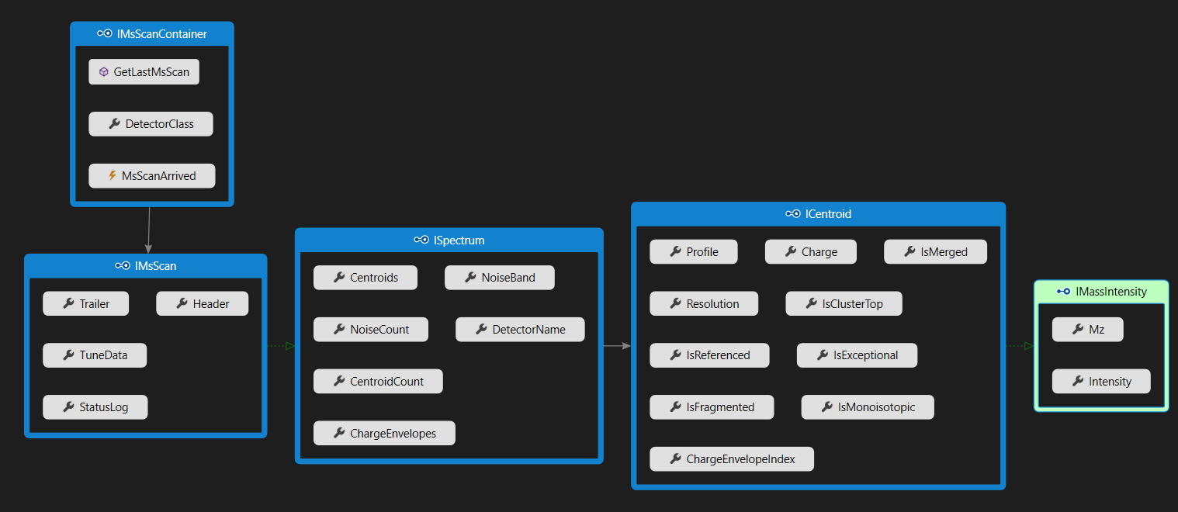
MS Scan Interfaces
IMsScanContainer exposes IMsScans
IMsScan contains metadata and derives from ISpectrum
ISpectrum contains a collection of ICentroids
ICentroids contains meta data and derives from IMassIntensity
IMassIntensity is the m/z and intensity data
Notes:
This show layers of interfaces in C#. I stands for interface. It shows the hiarachy from the user level down to the low level.
Ultimately you have a MSScan container, that has a event called MsScanArrived, that’s what you should subscribe to. You can have multiple listeners to that scan event.
When you get that event, you will get a copy of MSScans. A MsScan represents both spectrum and all the meta data with that spectrum, so like the Trailer data, the Header data the TuneData and anything like that.
So MSScan is derived from ISpectrum. It will contain a list of Centroids among other things. Centroids consist of a bunch of Icentroid, which contain charge, resolution, is monoisotopic. And Icentroid is derived from IMAssIntensity.

Slide 17
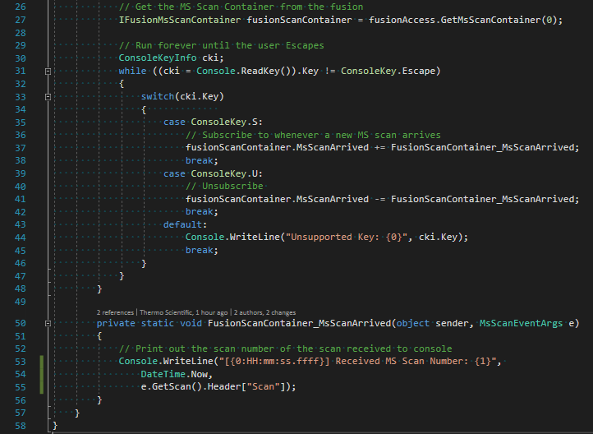
Scan Data Stream
Receiving the scan data is through the Event Driven programming model
Scans are sent via the .NET Event and EventHandler mechanism
Multiple handlers per scan can be registered
Minimal overhead and latency
Receives Scans from both Tune and Method acquisitions
This example is from the examples/tribrid/MinifiedExample/ directory in the Git repository
Notes:
This example is in GitHub, If you want to modify and look at it.
This show the bare minimum of the code behind to write sth that subscribe to MS scan event. This is an event driven programming model.
IFusionMsScanContainer is the basic API to get MsScan, there is only 1 of them.
Then here is a console app that basicly just waits util the key is escape.
Then the key is S means Subscribe to the MSScanEvent. So I register this call-back function. Or the key is U I unsubscribe that. I will show a demo in the next slice. And if it is other key, I default here.
What subscribe does is, this MsScanEvent, which has a function called getScan. I just print out from header the ScanNumber.

Slide 18
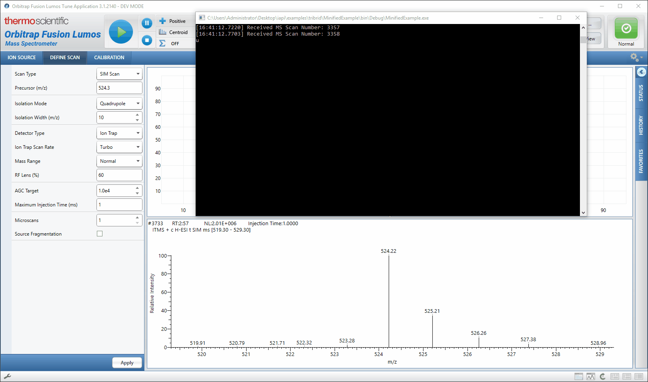
Scan Data Stream
Receiving the scan data is through the Event Driven programming model
Scans are sent via the .NET Event and EventHandler mechanism
Multiple handlers per scan can be registered
Minimal overhead and latency
Receives Scans from both Tune and Method acquisitions
tSIM running ~21 Hz (47.5 ms) from Tune.
Average time of 48.4 ms between scans received (n = 200)
This example is from the examples/tribrid/MinifiedExample/ directory in the Git repository
Notes:
Here I show you how you are running it. Now I hit S, u can see how fast it is, there is really no latency. Now I hit U to unsubscribe. So it doesn’t threat what actually is running, it just kind of listening to the data.

Slide 19
Scan Data Stream
Receiving the scan data is through the Event Driven programming model
Scans are sent via the .NET Event and EventHandler mechanism
Multiple handlers per scan can be registered
Minimal overhead and latency
Receives Scans from both Tune and Method acquisitions
tSIM running ~21 Hz (47.5 ms) from Tune.
Average time of 48.4 ms between scans received (n = 200)
The IAPI is responsive and has no impact on the MS acquisition
This example is from the examples/tribrid/MinifiedExample/ directory in the Git repository
Notes:
This is how I justify the latency. I ran a tSIM that was running at on average 47.5ms per scan. On the receiving side (Console app), it takes at 48.4ms between scans. So 1ms on average of latency

Slide 20
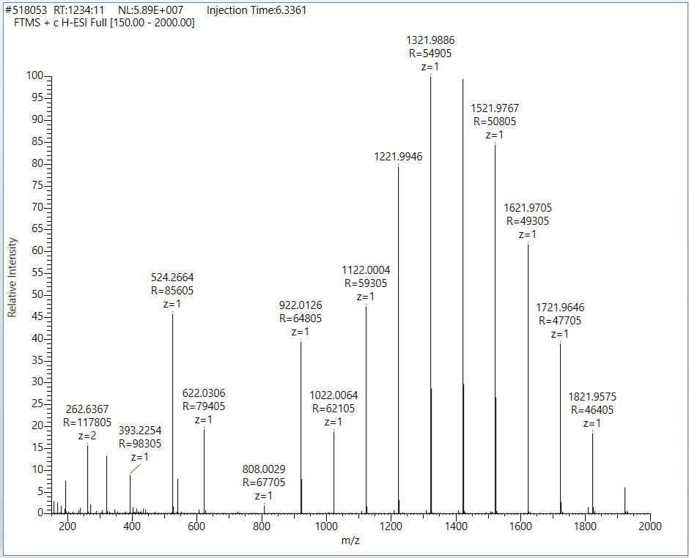
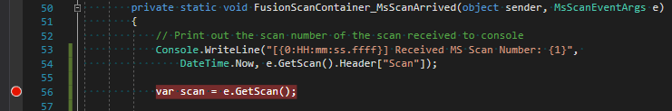
Scan Data Contents
Notes:
So I took that MSScanArrived handler, I put a break point here when I was running the program.

Slide 21
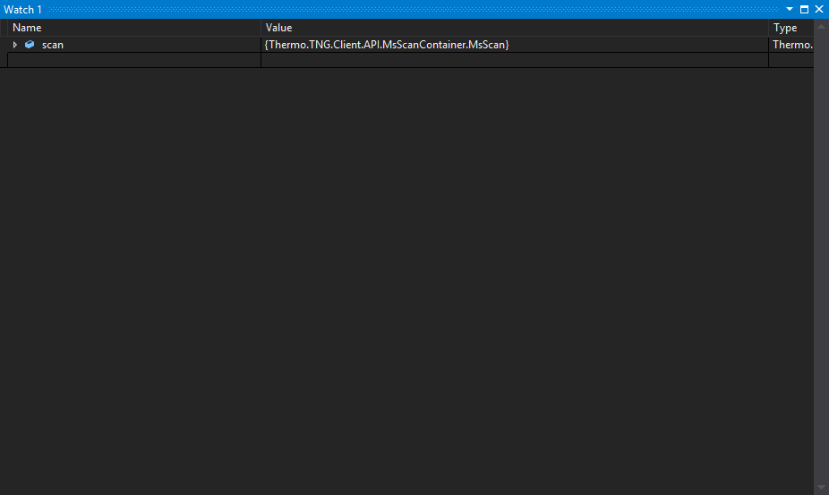
Scan Data Contents
Notes:
This just shows the data that contains there. All the mz peaks.
I just want to show, hey we gave you a lot of data, and you can do a lot with it. And it’s relatively easy to explore.

Slide 22
IAPI Outline
IAPI Architecture
Interfaces
Data and Control Flow
Receiving Data from the MS
Interfaces
Scan Data Stream Subscription
Controlling the MS
Sending Scan Definitions
Changing other MS parameters
Getting Started

Slide 23
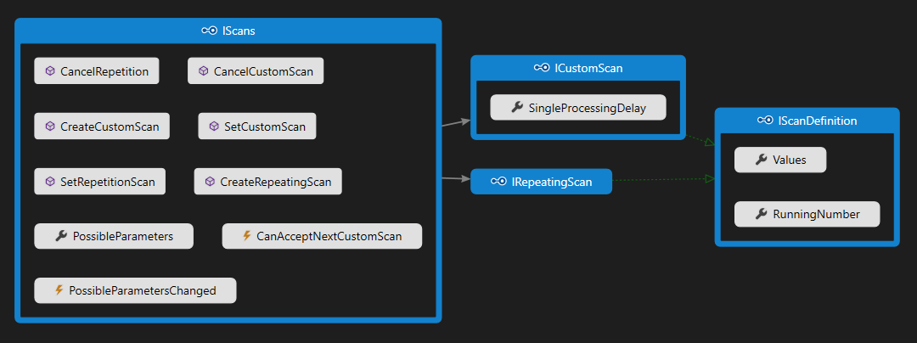
IScans Interface
Sending scans to the instrument is through the IScans interface
Provides methods for creating different types of IScanDefinitions
Provides methods for setting and cancelling scans.

Slide 24
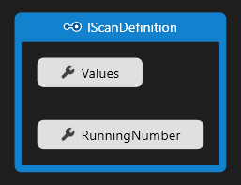
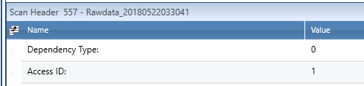
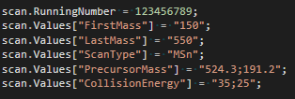
IScanDefinition
Scans are defined in the IScanDefinition interface
The RunningNumber property is for general purpose use
It shows up in the Scan Trailer as the ‘Access ID’ field
The Values property is a Dictionary<string,string>
Keys are the scan parameters
Values are their associated values
Values can take different formats based on the parameter
Invalid, or nonsense values, are ignored
Example of MS³ of 524@35 191@25
Scan 150 – 550 m/z

Slide 25
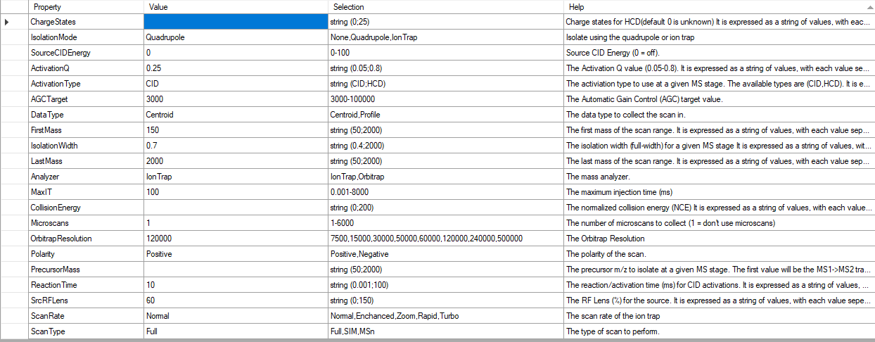
IScanDefinition

Slide 26
Scan Management
Mass Spectrometer
Local Switch
Data System
IAPI-Enabled App
Instrument
Service
3rd Party
Application
Sending Scan to MS

Slide 27
Scan Management
Mass Spectrometer
Local Switch
Data System
IAPI-Enabled App
Scan Hierarchy
Instrument
Service
3rd Party
Application
Custom
Repeating
Priority
Method
Tune
Sending Scan to MS

Slide 28
Scan Management
Scan Hierarchy
Custom
Repeating
Priority
Method
Tune

Slide 29
Scan Management - ICustomScan
Scan Hierarchy
Single scan, drops to lower level after completion
Custom
Repeating
Priority
Method
Tune

Slide 30
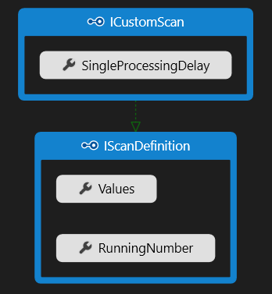
Scan Management - ICustomScan
Scan Hierarchy
Single scan, drops to lower level after completion
Custom
Repeating
Once executed, waits the Single Processing Delay (s) for a new Custom scan to arrive*
Default delay is 0 seconds (no waiting)
Immediately ends the wait if a new Custom scan arrives or there are pending ones
The Tribrid uses a circular buffer (40-capacity) to store them
Priority
Method
Tune
* Single Processing Delay is not enabled when occurring during Tribrid method acquisition, due to acquisition pipeline

Slide 31
Scan Management - IRepeatingScan
Scan Hierarchy
Custom
Repeats scan until explicitly canceled by user
Repeating
Priority
Method
Continually runs the same scan until:
Cancelled by the user
Replaced by a new Repeating Scan
Preempted by a Custom Scan
Tune

Slide 32
Scan Management - IRepeatingScan
Scan Hierarchy
Custom
Repeating
Priority
Runs Scans and logic defined in the method
Method
Tune
Runs the normal method logic until completion or new IAPI scan arrives

Slide 33
Scan Management - IRepeatingScan
Scan Hierarchy
Custom
Repeating
Priority
Method
Runs the Scan defined in Tune
Tune

Slide 34
Scan Management
Scan Hierarchy
Custom
Repeating
Priority
Method
Tune
Start Method
Time

Slide 35
Scan Management
Scan Hierarchy
Custom
Repeating
Priority
Method
Set Repeating
Tune
Start Method
Time

Slide 36
Scan Management
Scan Hierarchy
Custom
Repeating
Set Custom
Priority
Method
Set Repeating
Tune
Start Method
Time

Slide 37
Scan Management
Scan Hierarchy
Custom
Repeating
Set Custom
Priority
Canceled Repeating
Method
Set Repeating
Tune
Start Method
Time

Slide 38
Scan Management
Scan Hierarchy
Custom
Repeating
Set Custom
Priority
Canceled Repeating
Method
Set Repeating
Tune
Start Method
Time

Slide 39
Scan Management
Scan Hierarchy
Custom
Repeating
Set Custom
Priority
Canceled Repeating
Method
Set Repeating
Method Completed
Tune
Start Method
Time

Slide 40
Scan Management
Scan Hierarchy
Custom
Repeating
Set Custom
Priority
Canceled Repeating
Method
Set Repeating
Method Completed
Tune
Start Method
Time

Slide 41
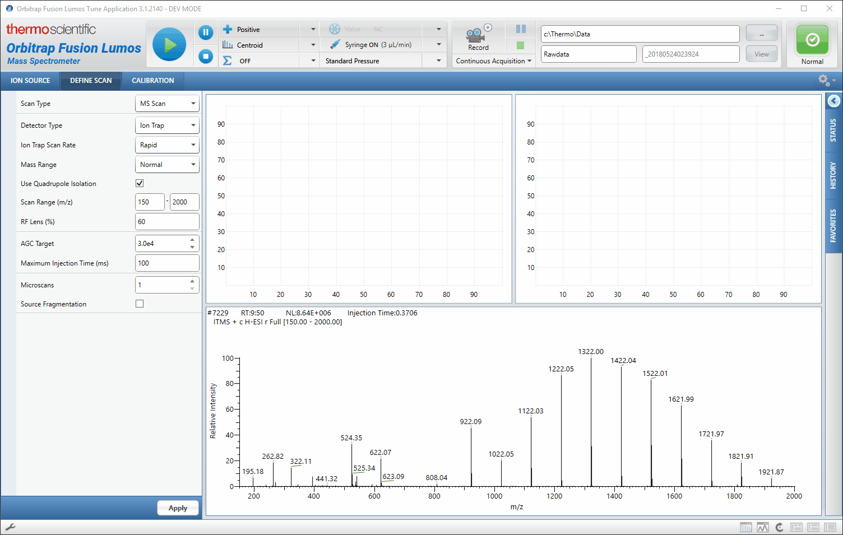
Scan Management
Scan Hierarchy
Custom
Repeating
Priority
Method
Tune

Slide 42
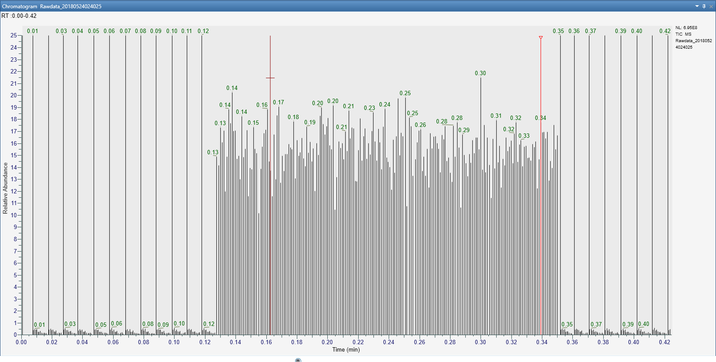
Scan Management
Scan Hierarchy
Custom
Repeating
Priority
Method
Tune
Method Scans
IAPI Scans
Method Scans

Slide 43
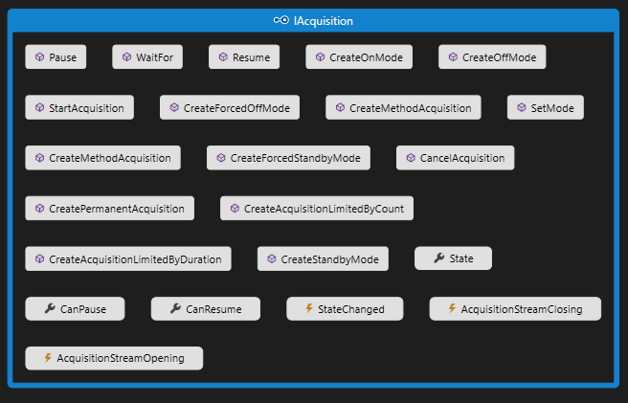
Starting Acquisitions from the IAPI
The IAcquisition interface enables the IAPI to start/stop acquisitions
It also has Events for listening to when an acquisition starts and stops

Slide 44
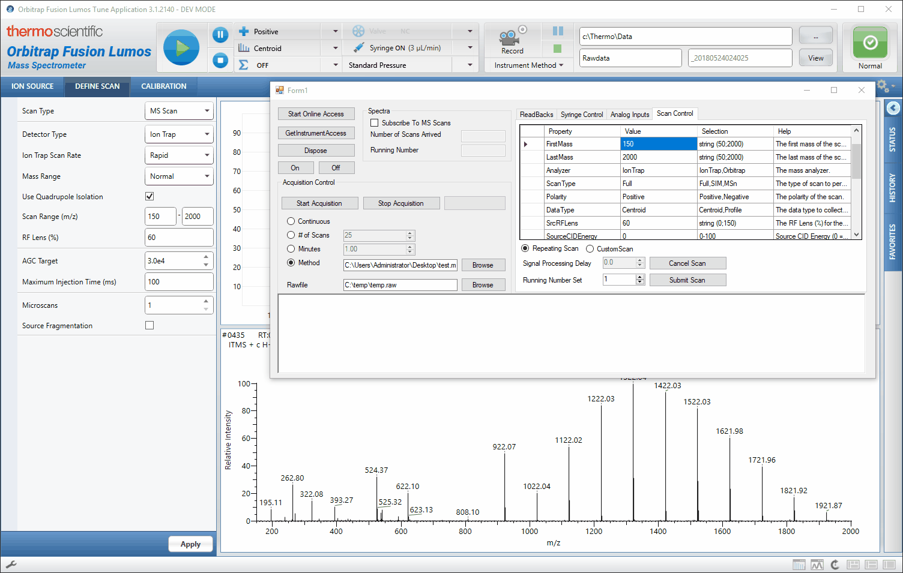
Starting Acquisitions from the IAPI
The IAcquisition interface enables the IAPI to start/stop acquisitions
It also has Events for listening to when an acquisition starts and stops

Slide 45
IAPI Outline
IAPI Architecture
Interfaces
Data and Control Flow
Receiving Data from the MS
Interfaces
Scan Data Stream Subscription
Controlling the MS
Sending Scan Definitions
Changing other MS parameters
Getting Started

Slide 46
License Activation
Access to the IAPI is given after a fully executed IAPI License is in force.
Contact info.IAPI@thermofisher.com to get started
https://github.com/thermofisherlsms
Please include which IAPI (Tribrid or Exactive) you would like access to in your initial correspondence
Notes:
To get start with it, we have this ThermoMSLicesing account. Or the easiest way would be to go to our github page. There needs some paper work

Slide 47
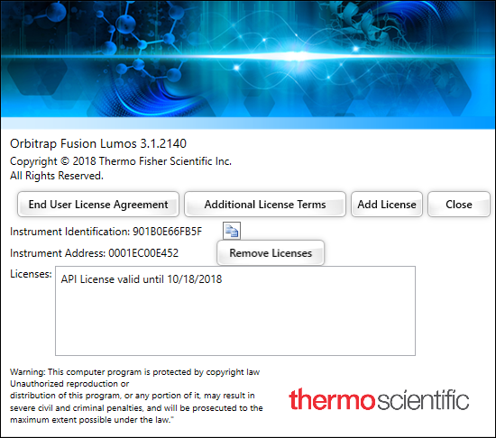
License Activation
Access to the IAPI is given after a fully executed IAPI License is in force.
Contact info.IAPI@thermofisher.com to get started
Please include which IAPI (Tribrid or Exactive) you would like access to in your initial correspondence
A license key will be provided to you and is entered in Tune’s “About Tune” dialog
Restart both the Instrument and Data system computer and the API will be enabled
Activating the License on the Tribrids
Notes:
After signing the license, we will provide with a licence key according to your instrument ID number. And you can just add license here.

Slide 48
Overview
Instrument Application Programming Interface (IAPI)
Introduction
Architecture
Example
XML Method Modification Interface (XMMI)
Architecture
Example
Notes:
Overview of the first half of today
Some special guest presenters on their experience using these tools

Slide 49
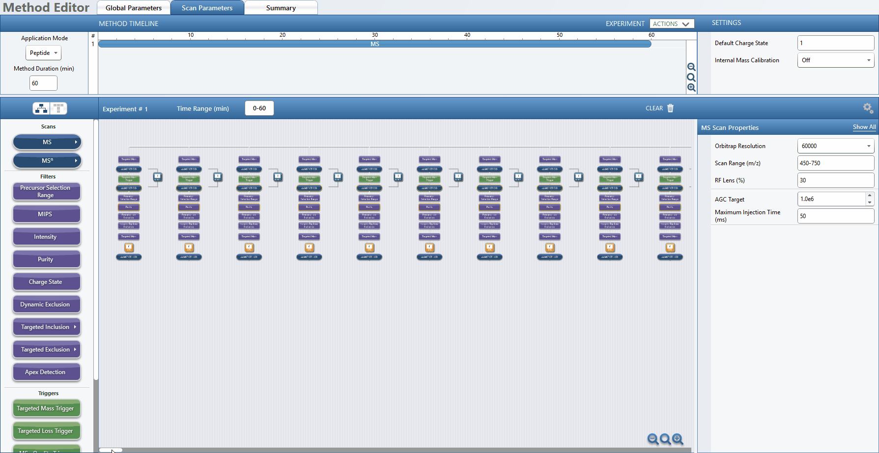
The Method Editor offers tremendous flexibility in method creation;
sometimes manually editing complex methods is laborious.
Method courtesy of Christopher Rose

Slide 50


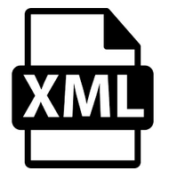
Programmatically Modify Fusion Methods
Method File
XML Method
Modification Interface
Modified
Method File
Modifications

Slide 51
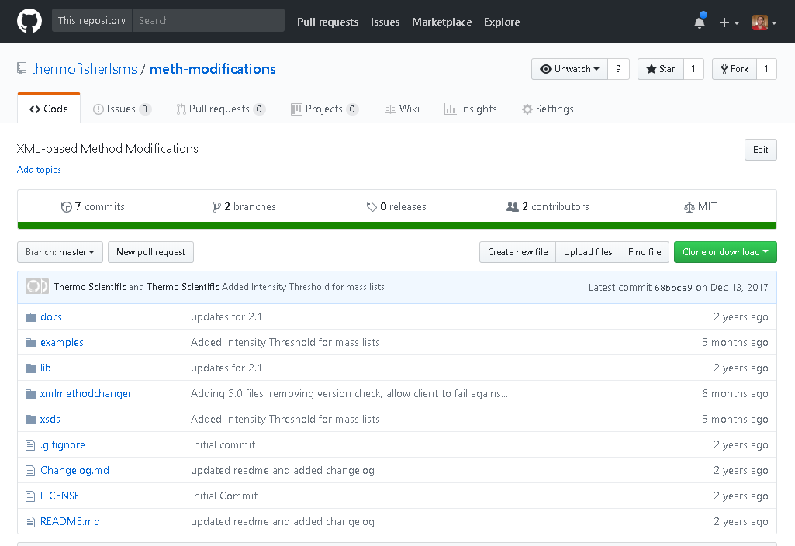
Method Modifications Git Repository
https://github.com/thermofisherlsms/meth-modifications
Supports Fusion and Triple-Quad Methods
Versions 1.2, 2.0, 2.1, 3.0, 3.1, 3.3
Documentation
Complete Examples
VS Solution
Command Line Program
Heavily commented code
Schemas
External Requirements
Tune Installation
Full or Workstation
.NET 4.6.2+

Slide 52
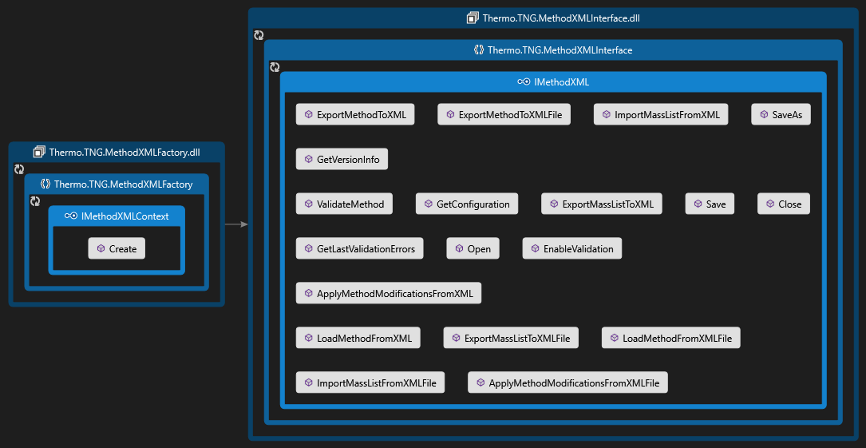
XML Modification Interfaces
Notes:
Here I show the two interfaces we use in XML Modification.
Thermo.TNG.MethodXMLFactory.dll
Thermo.TNG.MethodXMLInterface.dll
To compile, you need to include both assemblies.

Slide 53
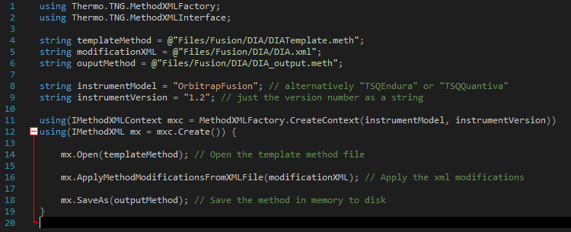
Complete Code Example
Notes:
Top two line are including assemblies.
The following line 4 to 6 are templateMethod, modificationXML, and the outputMethod.
Following we specify the Model and version.
Here we create the context given the Model and Version. We open the template, apply the modification, and eventually save it.

Slide 54
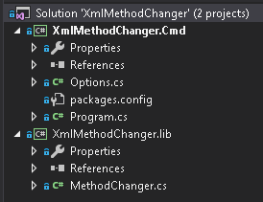
Method Modifications Visual Studio Solution
The XmlMethodChanger Solution contains two projects
XmlMethodChanger.lib
A public, static class library (MethodChanger)
Wraps the two Thermo.TNG.*.dll assemblies
Provides public methods for common tasks
Serves as an example of the API Usage
XmlMethodChanger.cmd
Command-line program that uses XmlMethodChanger.lib
Uses third-party NuGet package (Command Line Parser Library)
Can be used as a standalone tool for modifying methods
Notes:
This is a solution in GitHub. A command line program for running that. It consists of two projects, one is the library. It kind of just wrap the two assemblies. Project 2 is the .cmd, the command line prgoram that calls the library to do the work, provide an interface to the command line.

Slide 55
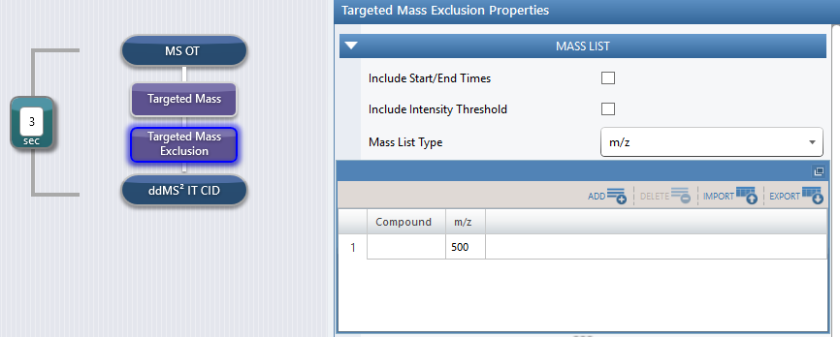
Demonstration
The “template” method contains the structure of the experiment
This example is from the examples/Fusion/IntensityThreshold/ directory in the Git repository
Notes:
This is a sample in Github down here. This is a template method, I just made a targeted mass exclusion list that has mothing in there.

Slide 56
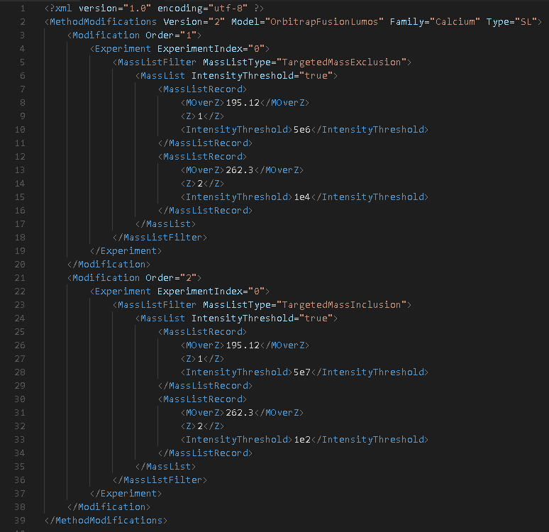
Demonstration
The “template” method contains the structure of the experiment
The modification XML specifies a list of transformations to perform on the “template” method file
This example is from the examples/Fusion/IntensityThreshold/ directory in the Git repository
Notes:
Here I write the XML modification.
I’m adding a couple of entries, 195, 262 to this targeted mass exclusion.
For the targetedMassInclusion, I’m adding the same mass but at a different intecity threshold, 5e7 and 1e2.

Slide 57
Demonstration
The “template” method contains the structure of the experiment
The modification XML specifies a list of transformations to perform on the “template” method file
The transformed method can then be saved to a separate .meth file
This example is from the examples/Fusion/IntensityThreshold/ directory in the Git repository

Slide 58
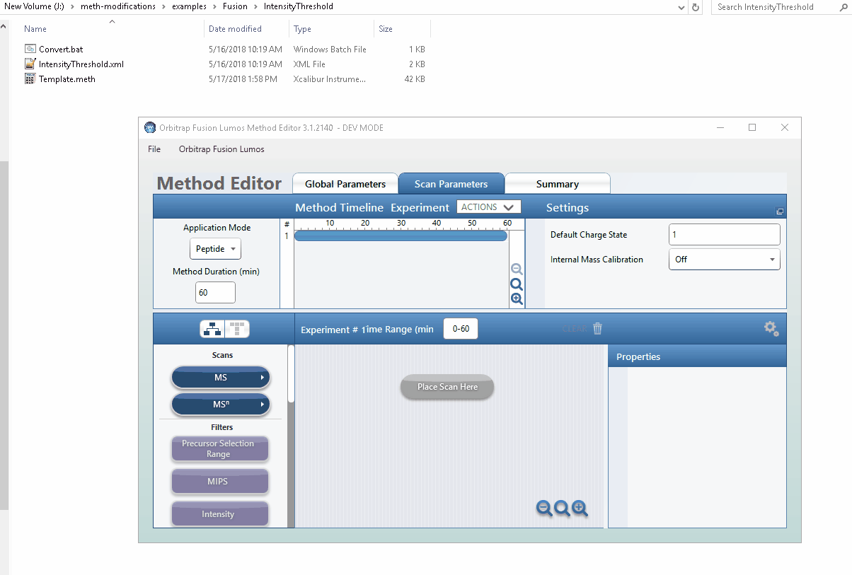
Demonstration
This example is from the examples/Fusion/IntensityThreshold/ directory in the Git repository
Notes:
I load the template in, there is nothing in there. Now I ran the bat script, which will call the command line to modify the template based on the XML. It generates the new one, I load it into the methodEditor, and you can see it loads the new data according to our numbers in xml.

Slide 59
THANK YOU!

